Slide 1


+++ Live +++ +++ Live +++ +++ Live +++
Welcome
to
Software Engineering
Lesson WS2020/2021
Starting at 14:15
survey

Slide 2

+++ Live +++ +++ Live +++ +++ Live +++
The rule No1
Keep your camera on

Slide 3

Software Engineering
WS-2020-2021
21. Oct
28. Oct
Lesson Mo. 14.15-17.45 h Lab: Mo. 17.45-19.00 h
Room 8-103
04.Nov
11.Nov
18.Nov
25.Nov
02.Dec
09.Dec
16.Dec
13.Jan
20.Jan
27.Jan
03.Feb
10.Feb
https://www.linkedin.com/groups/8689804/

Slide 4


Who am I?
Damir Dobric
Microsoft PTSP (Partner Technical Solution Specialist) Microsoft Most Valuable Professional
Blog
Twitter
damir.dobric@daenet.com b-dadobr@microsoft.com
https://damirdobric.me

Slide 5
+++ Live +++ +++ Live +++ +++ Live +++
.NET Core / C#

Slide 6
AGENDA
What is .NET Core?
Why .NET Core?
Supported platforms
Not supported platforms

Slide 7
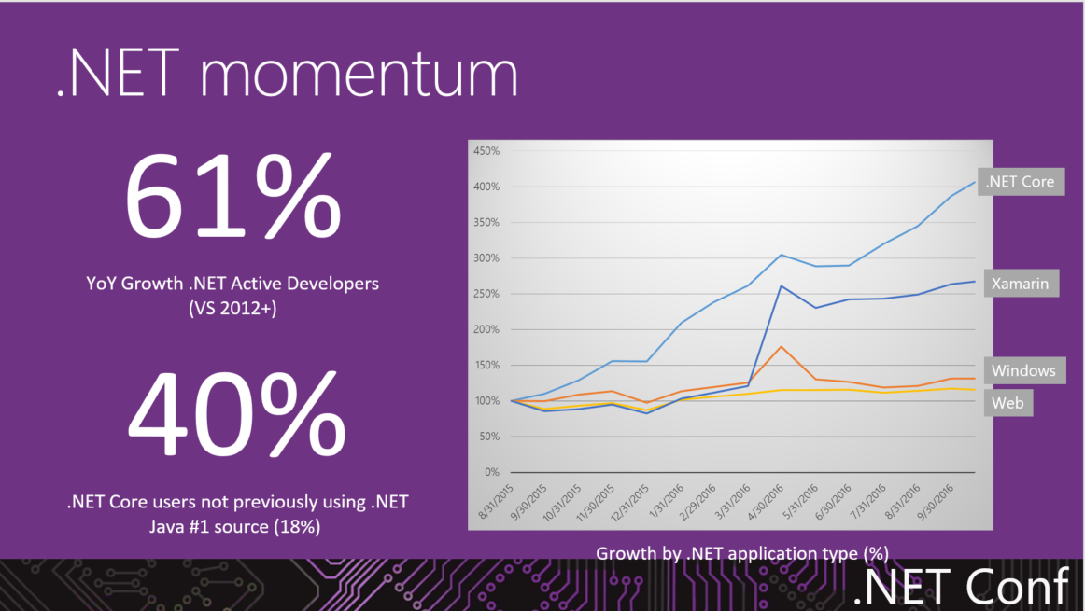

Slide 8
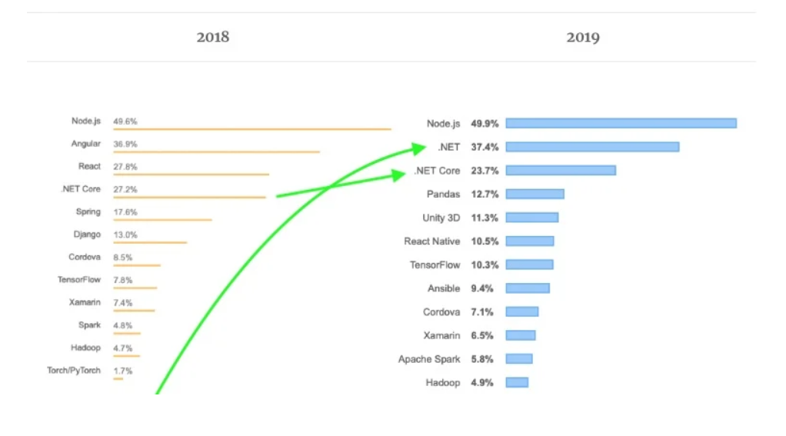
https://insights.stackoverflow.com/survey/2020#developer-profile-gender-professional-developers2

Slide 9
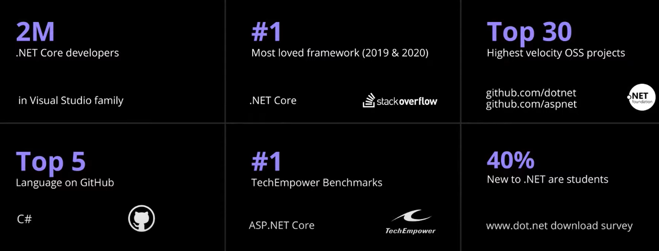

Slide 10
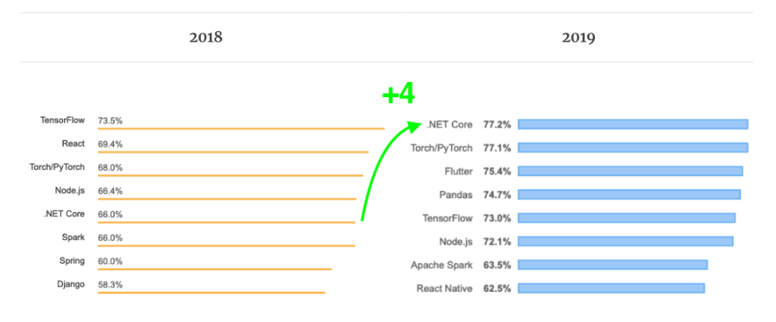
Most loved source: stack overflow
https://codinginfinite.com/stack-overflow-developers-survey-2019-vs-2018-technology-comparison/

Slide 11
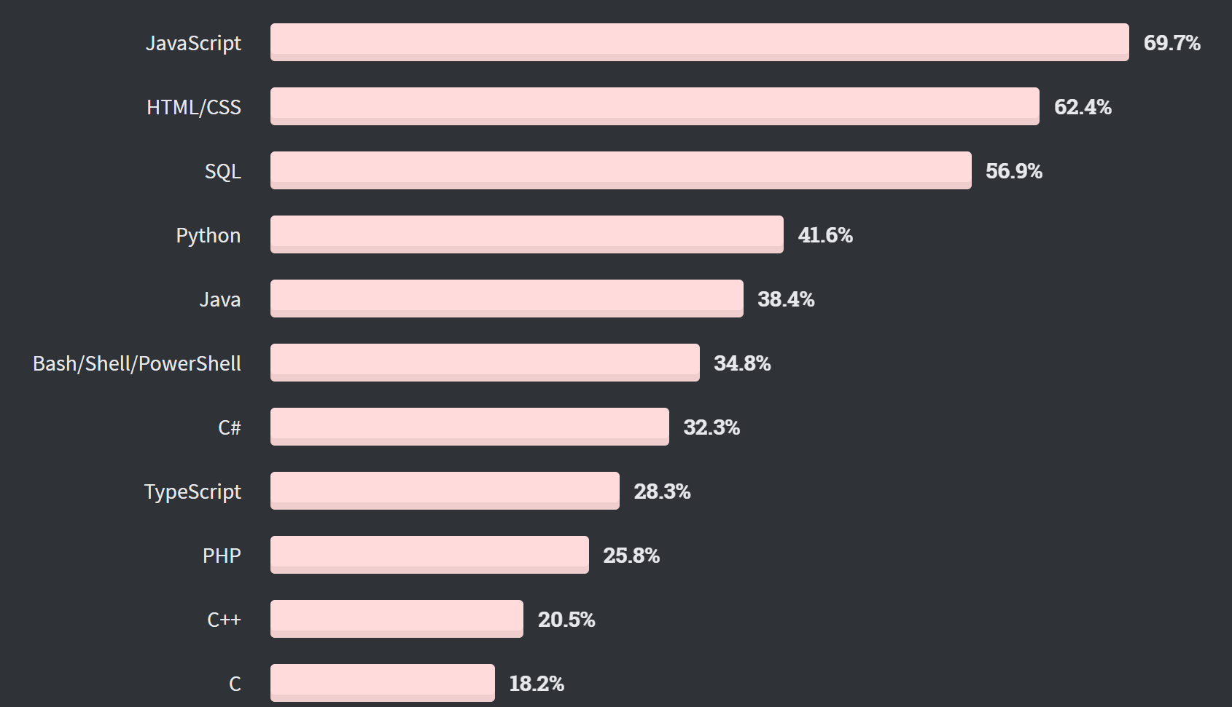

Slide 12
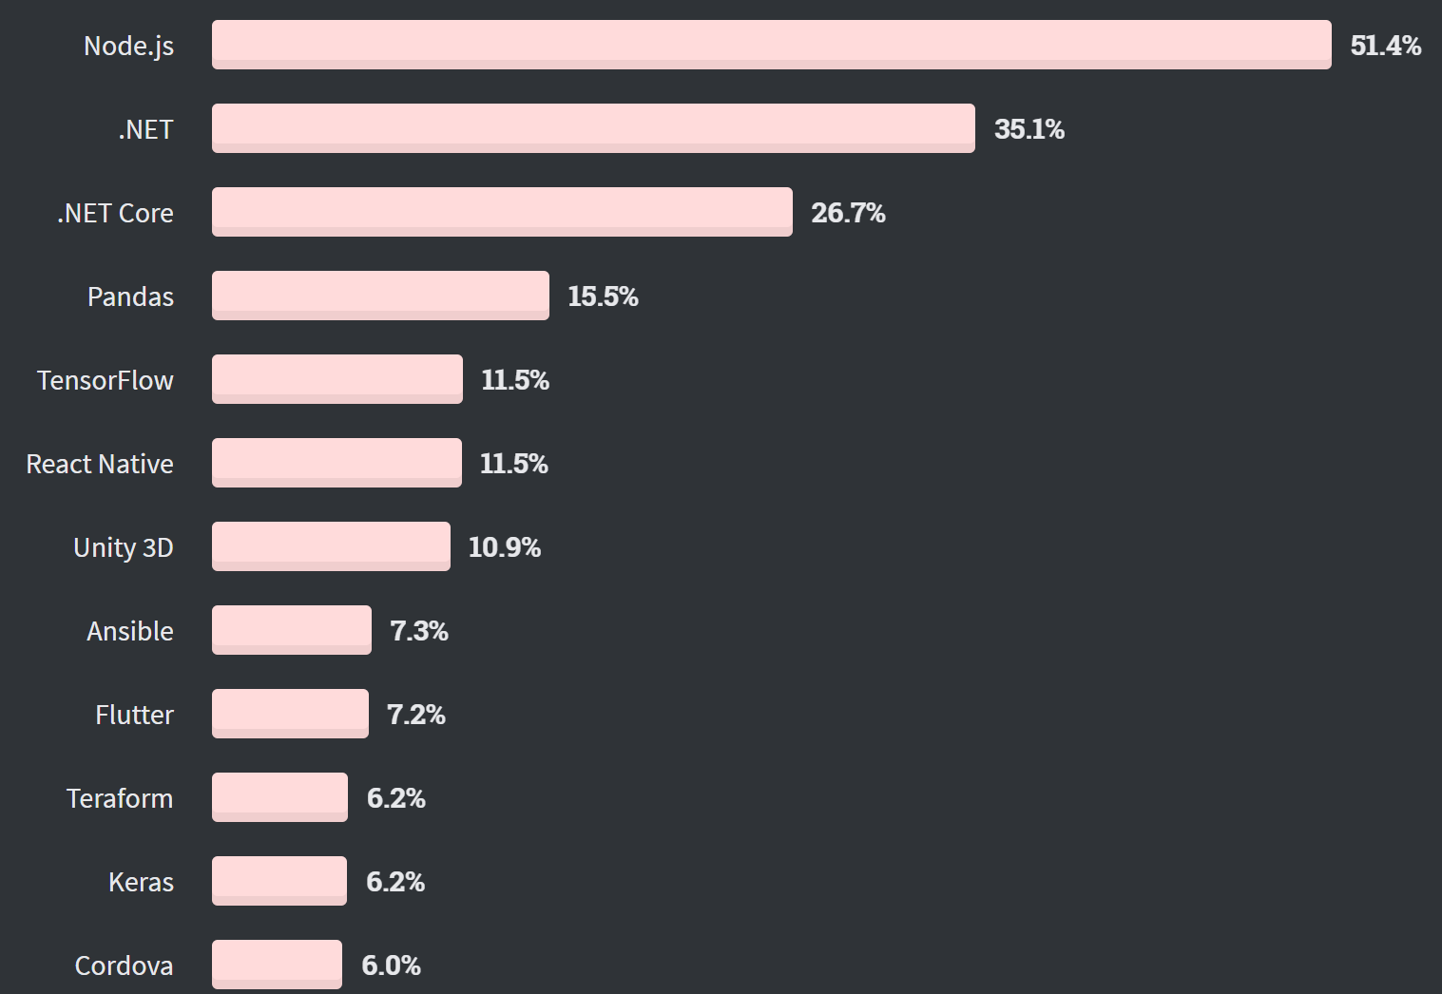

Slide 13
Learning C#
https://www.microsoft.com/net/tutorials/csharp/getting-started

Slide 14
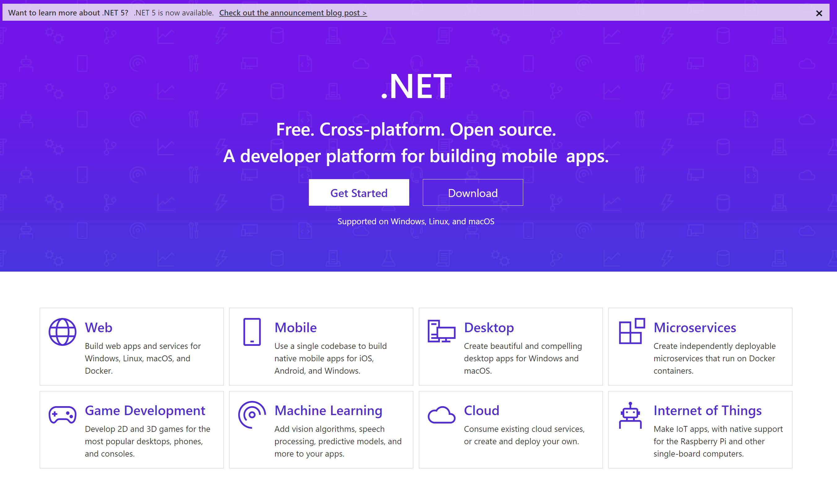
Where to start?
https://dotnet.github.io
https://dotnet.microsoft.com

Slide 15
any platform, any application, any developer

Slide 16
.NET Core is
a general purpose development platform
with cross-platform support for
Windows, macOS and Linux, various devices and cloud

Slide 17
What is .NET Core?
.NET Core is free Open Source and cross platform framework.
Originally invented for Cloud Development but:
Web,
microservices,
mobile,
desktop,
games,
AI/ML
IoT
https://github.com/dotnet/core/blob/master/release-notes/5.0/5.0-supported-os.md

Slide 18
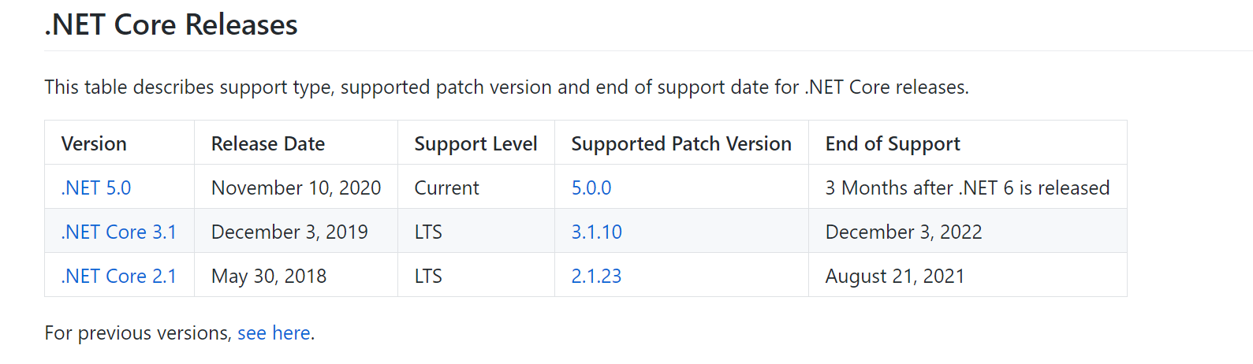
https://github.com/dotnet/core/blob/master/microsoft-support.md

Slide 19






Inside of .NET Core
runtime
libraries
tools
compilers
host

Slide 20

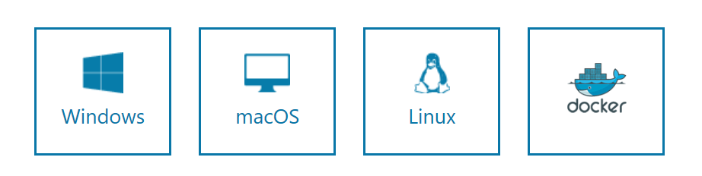
https://www.microsoft.com/net/download/core
> C:\Program Files\dotnet

Slide 21
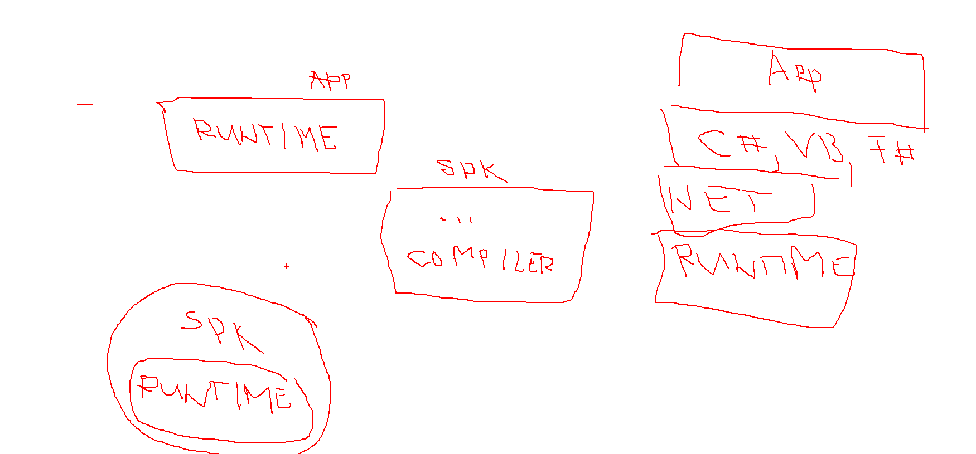
Runtime vs SDK (software development kit)

Slide 22
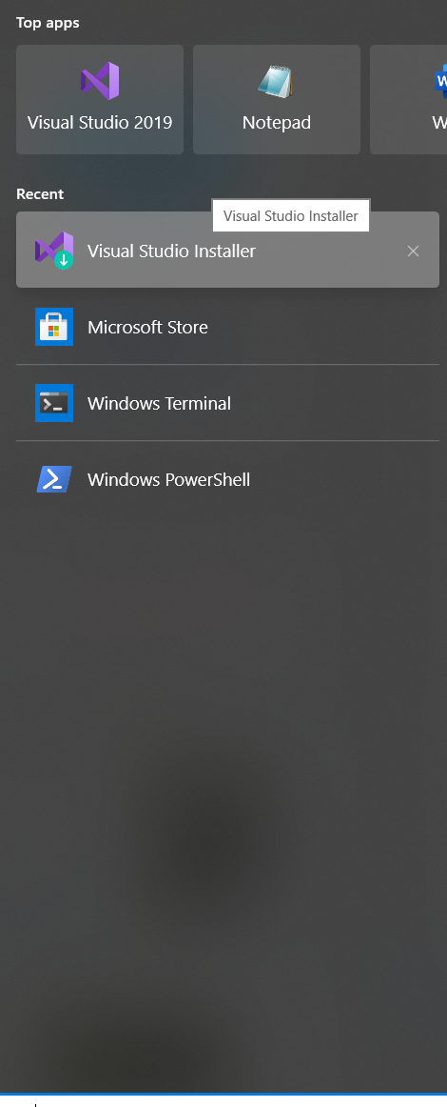
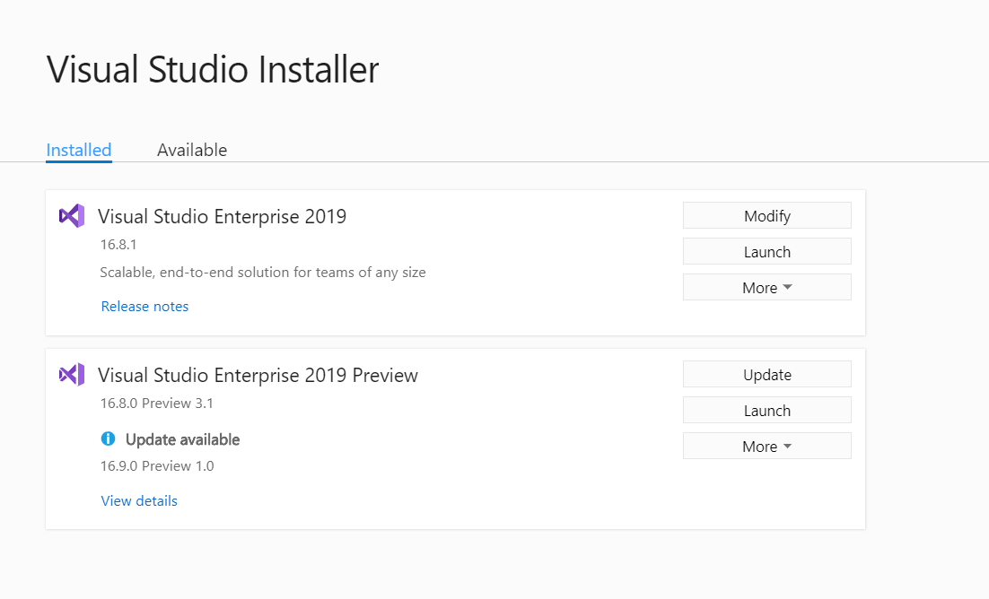
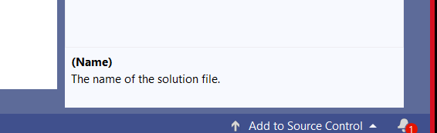
How to update Visual Studio?

Slide 23
BREAK
Break: 15:30 – 15:45

Slide 24
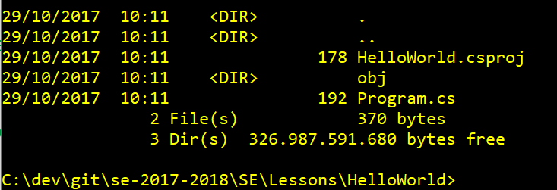
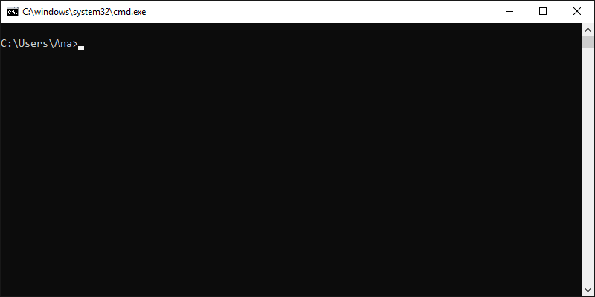
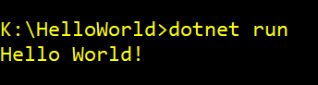
Create your first .NET Core application
//Create a new folder
mkdir YOURAPP
// Go to folder
cd YOURAPP
// Create a new .NET Core project
dotnet new console
// Create a new .NET Core project
dotnet restore
// Build the project
Dotnet build
// Run application
dotnet run
https://dotnet.microsoft.com/learn/dotnet/hello-world-tutorial/create

Slide 25
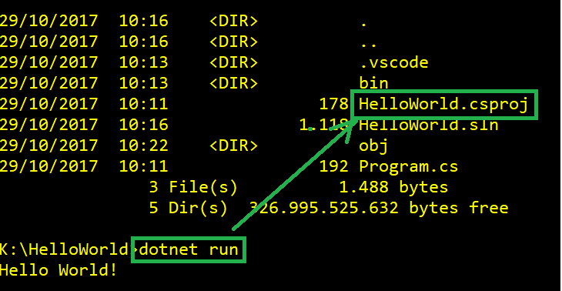
Running build
If you have a source code and command prompt is in folder which contains project file csproj, then you cas simply use dotnet run.

Slide 26
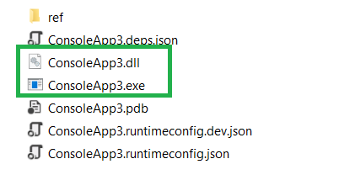
Running application without “csproj”
.NET Core application is a DLL (Dynamic Link Library)
dotnet ConsoleApp3.dll
ConsoleApp3.exe

Slide 27
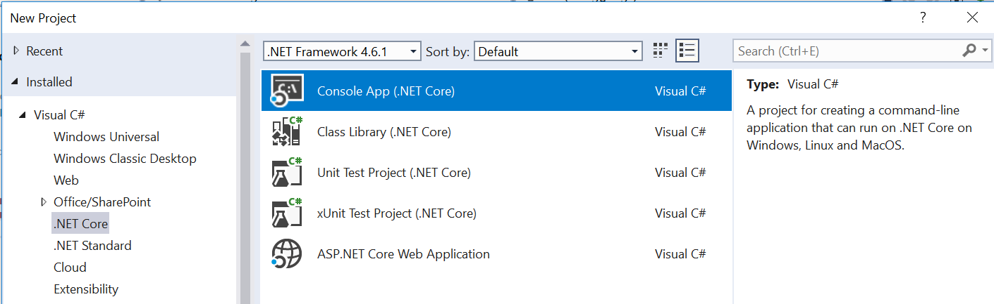
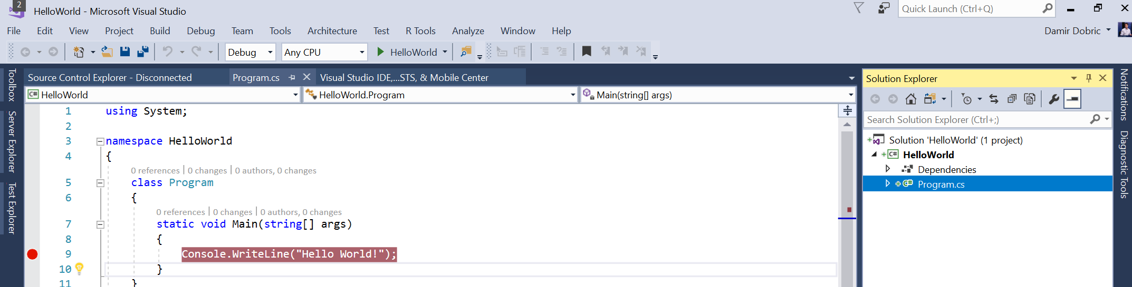
Create an application with Visual Studio

Slide 28
Exercises
E1 - Install .NET5 (you can install VS)
E2 - Create your first program with command line
E3 - Create your first program with Visual Studio
E4 – Learn about Structure of Application.

Slide 29
(E1) Install VS & .NET Core SDK
The best way to develop with .NET Core on Windows is using Visual Studio. We will work in course with this version.
You can alternatively use download Visual Studio Code.
Download .NET CORE SDK (don’t need if VS installed) https://www.microsoft.com/net/download/core
For Linux friends https://docs.microsoft.com/en-us/dotnet/core/install/linux-ubuntu#2004-
C:\Users\YOURUSERNAME\AppData\Local\Packages\CanonicalGroupLimited.Ubuntu20.04onWindows_79rhkp1fndgsc\LocalState\rootfs\home\YOURUSERNAME

Slide 30
(E2)Create a project with command line
//Create a new folder
mkdir YOURAPP
// Go to folder
cd YOURAPP
// Create a new .NET Core project
dotnet new
// Create a new .NET Core project
dotnet restore
// Build the project
dotnet build
// Run application
dotnet run

Slide 31
(E3)Create Application in VS
In Solution Explorer, open the context menu for the Console Application (.NET Core) project. Name it "App", and set some the location. .
Open the Program.cs and paste following code:
Set a breakpoint after the line that you just added.
Press F5 to run the application..
The application should build without error and should hit the breakpoint.
using System;
namespace ConsoleApplication
{
public class Program
{
public static void Main(string[] args)
{
Console.WriteLine("Hello World!");
}
}
}

Slide 32
(E4)Structure of App & Reading Files
The basics of the .NET Core Command Line Interface (CLI).
The structure of a C# Console Application.
Reading from File
Writing output to console
The basics of the Task Asynchronous Programming Model in .NET Core.
https://docs.microsoft.com/en-us/dotnet/articles/csharp/tutorials/console-teleprompter

Slide 33
Exercises
Th
14:00-16:00

